Slide 1
Operating System and System Design Lecture A
April 11, 2020

Slide 2
Operating System and System Design Lecture 1
April 4, 2020

Slide 3


Why do we need a system design?
Information exploded over the last few decades and continues to be exploding, …
Internet companies such as Google, Yahoo!, Amazon, Facebook, LinkedIn, Microsoft, and Twitter are handling huge volumes of data and traffic, forcing them to create new tools that enable them to efficiently handle such scale.
CPU clock speeds are barely increasing, but multi-core processors are standard, and networks are getting faster. This means parallelism is only going to increase.

Slide 4
Foundation of Data System
Building blocks
Store data so that other application can find it again later (database)
Remember the result of an expensive operation to speed up reads (cache)
Allow users to search and retrieve data by keyword (indexing)
Send a message to another process, to be handled asynchronously (stream processing)
Periodically crunch a large amount of accumulated data (batch processing)
Multiple ways of implementing those system, know pros and cons of each implementation.
Design is all about trade-off!

Slide 5
Foundation of Data System
Reliability
The system should continue to work correctly (performing the correct function at the desired level of performance) even in the face of adversity (hardware or software faults, and even human error)
Scalability
As the system grows (in data volume, traffic volume, or complexity), there should be reasonable ways of dealing with that growth.
Maintainability
Over time, many different people will work on the system (engineering and operations, both maintaining current behavior and adapting the system to new use cases), and they should all be able to work on it productively

Slide 6
Foundation of Data System (Reliability)
Hardware failure
Hard disks crash
RAM becomes faulty
The power grid has a blackout
Someone unplugs the wrong network cable
Software failure
Bugs
A runaway process take all the shared resources
A service that it depends on becomes unreliable
Human error
configuration errors by operators

Slide 7
Foundation of Data System (Scalability)
Describing load
Post tweet
A user can publish a new message to their followers (4.6k requests/s on average, over 12k requests/s at peak).
Home timeline
A user can view tweets posted by the people they follow (300k requests/sec).
Describing performance
Throughput (Batch): the number of records we can process per second, or total time for run a job .
Response time (Service): the time between a client sending a request and receiving a response.
average response time
percentiles, tail latency
service level objectives (SLOs) and service level agreements (SLAs), promise and measurement
Approaches for Coping with Load
scaling up (vertical scaling, moving to a more powerful machine)
scaling out (horizontal scaling, distributing the load across multiple smaller machines).

Slide 8
Data Models and Query Languages
Relational Model & Document Model
The best-known data model today is probably that of SQL, based on the relational model proposed by Edgar Codd in 1970 [1]: data is organized into relations (called tables in SQL), where each relation is an unordered collection of tuples (rows in SQL)
Schema:
Bad Locality: Either perform multiple queries (query each table by user_id) or perform a messy multi-way join between the users table and its subordinate tables.
Query Languages: SQL (SELECT, UPDATE, DELETE, JOIN, …)

Slide 9
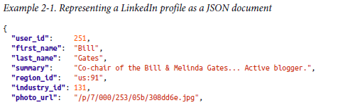
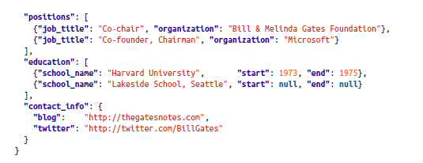
Data Models and Query Languages
Pros:
In the JSON representation, all the relevant information is in one place, and one query is sufficient.
Cons:
Text Duplication
Non-Consistent style and spelling across profiles
Extremely difficult to update fields

Slide 10
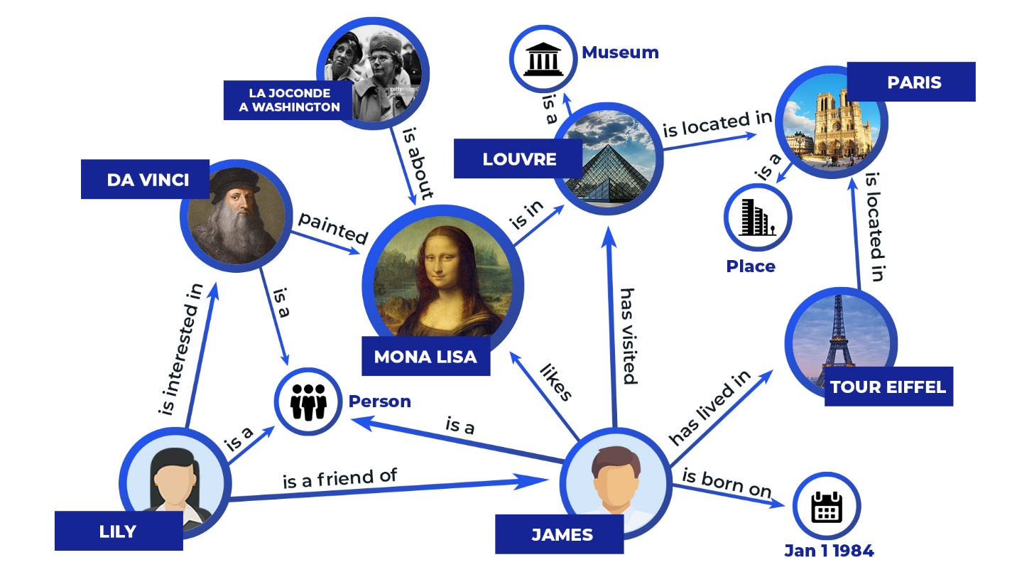
Graph-Like Data Models
A graph consists of two kinds of objects:
vertices (also known as nodes or entities)
edges (also known as relationships or arcs).
Social graphs
Vertices are people, and edges indicate which people know each other.
The web graph
Vertices are web pages, and edges indicate HTML links to other pages.
Road or rail networks
Vertices are junctions, and edges represent the roads or railway lines between them.

Slide 11
Storage and Retrieval
On the most fundamental level, a database needs to do two things:
when you give it some data, it should store the data
when you ask it again later, it should give the data back to you.
A simple database to start with…
#!/bin/bash
db_set () {
echo "$1,$2" >> database
}
db_get () {
grep "^$1," database | sed -e "s/^$1,//" | tail -n 1
}
Performance Analysis:
Good performance for db_set, Efficient write, O(1)
Terrible performance for db_get, O(n)

Slide 12
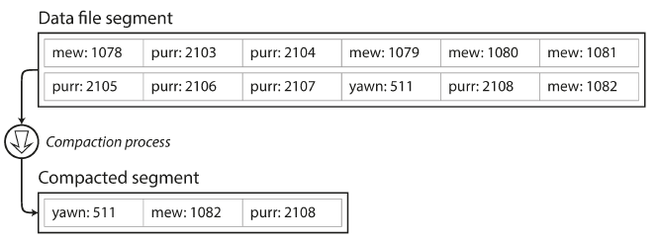
Storage and Retrieval (Cont’d)
How to improve the previous system?
keep an in-memory hash map where every key is mapped to a byte offset in the data file—the location at which the value can be found.
Question:
How to look up a value (read) ?
How to insert or update a new key-value pair (write)?
High performance read and write
Storing a log of key-value pairs in a CSV-like format, indexed with an in-memory hash map.
Follow-up:
How do we avoid eventually running out of disk?
Compaction: break the log into segments of a certain size by closing a segment file when it reaches a certain size, and making subsequent writes to a new segment file.

Slide 13
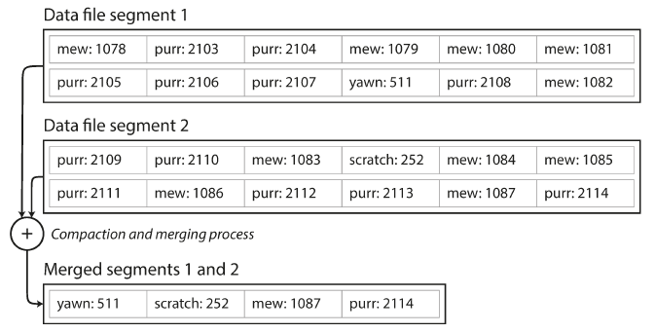
Storage and Retrieval (Cont’d)
Performing compaction and segment merging simultaneously
Question:
What has changed (read vs. write) ?
How to delete a record? (tombstone)
How to recover from crash?
What kind of concurrency control we can provide?
Limitations
The hash table must fit in memory
Range queries are not efficient
How can we improve?

Slide 14
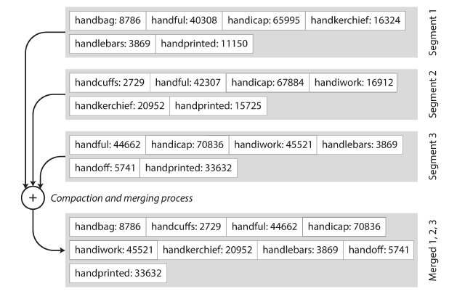
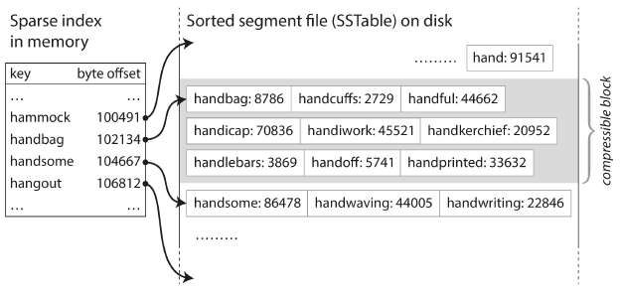
SSTables and LSM-Trees
Make the segment file (key-value file) sorted by key
Invented by Google
Implemented and widely used in Open Source Infrastructure
Pros:
Merging segments is simple and efficient (mergesort);
No need to keep an index of all the keys in memory;
Scan blocks anyway, group records and compress before write to disk; reduce I/O bandwidth;
How to get sorted data in the first place? Available data structure?
Write
Write in-memory balanced tree data (memtable)
Dump memtable into disk as SSTable when size above threshold
Read
Find key in memtable first, then in most recent on-disk segment, then next-older one, … (Bloom filters)
Run merge and compaction process in the background
Fay Chang, Jeffrey Dean, Sanjay Ghemawat, et al.: “Bigtable: A Distributed Storage System for Structured Data,” at 7th USENIX Symposium on Operating System Design and Implementation (OSDI), November 2006.

Slide 15
SSTables and LSM-Trees (Cont’d)
How to avoid loss when database crashes?
Keep a separate log on disk, immediately append for write
Sequential write, no need to keep sorted order, only for recovery use
Performance Analysis
Works well when the data is much bigger than the available memory
Efficiently perform range queries
Remarkably high write throughput
Variants
size-tiered compaction
leveled compaction (LevelDB)
Fay Chang, Jeffrey Dean, Sanjay Ghemawat, et al.: “Bigtable: A Distributed Storage System for Structured Data,” at 7th USENIX Symposium on Operating System Design and Implementation (OSDI), November 2006.

Slide 16
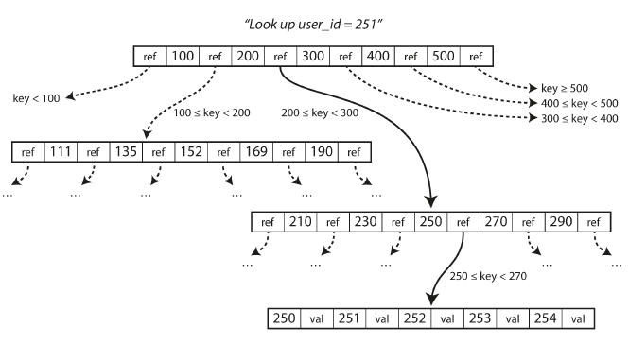
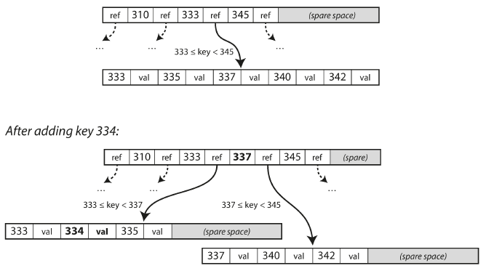
B-Trees
Most widely used indexing structure, stood the test of time very well
Details:
Break the database down into fixed-size blocks or pages (4KB)
Read or write one page at a time; close to underline hardware
Page contains several keys and references to child pages. Each child is responsible for a continuous range of keys.
Read: Start from root page until the value is found
Write:
Search for the leaf page containing that key, change the value in that page, and write the page back to disk
Find the page whose range encompasses the new key and add it to that page. No enough space? Split into two pages.
Performance
Balanced, has a depth of O(log n). A four-level tree of 4 KB pages with a branching factor of 500 can store up to 256 TB.
Looking up a key using a B-tree index
Growing a B-tree by splitting a page

Slide 17
B-Trees and LSM-Trees
Comparison:
LSM-trees are typically faster for writes, B-trees are thought to be faster for reads
Reads are typically slower on LSM-Trees due to check multiple segments
B-Trees:
Write every piece of data at least twice
Leave some disk space unused due to fragmentation
LSM-Trees:
Rewrite data multiple times due to repeated compaction and merging of SSTables.
Write amplification cost: 1) disk durability, 2) slow when heavy writes due to limited I/O bandwidth if not well-configured;
Produce less fragmentation
At higher percentiles, response time can be quite high

Slide 18
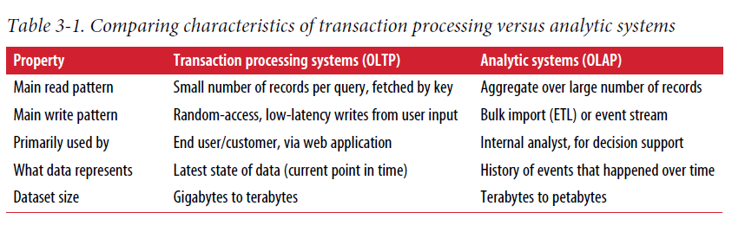
Transaction Processing or Analytics?
Some Background & History …
In the early days of business data processing, a write to the database typically corresponded to a commercial transaction taking place: making a sale, placing an order with a supplier, paying an employee’s salary, etc. As databases expanded into areas that didn’t involve money changing hands, the term transaction nevertheless stuck, referring to a group of reads and writes that form a logical unit.

Slide 19
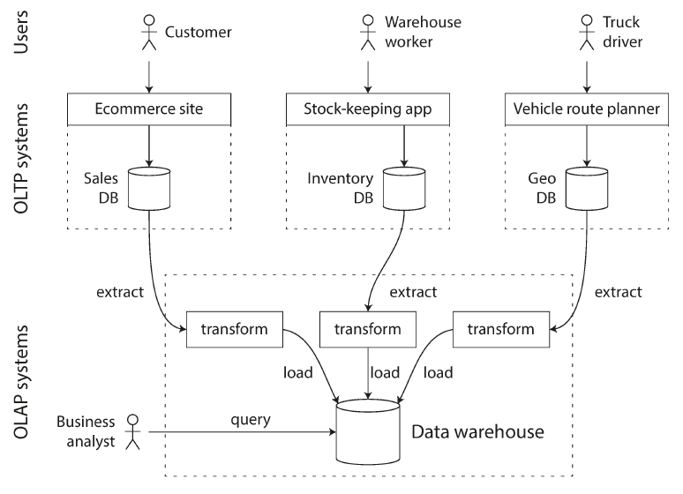
Transaction Processing or Analytics Examples
Generally, OLAP system doesn’t have high demands for processing real-time, the data can be processed and restored in a way that’s more efficient for analytic access patterns.

Slide 20
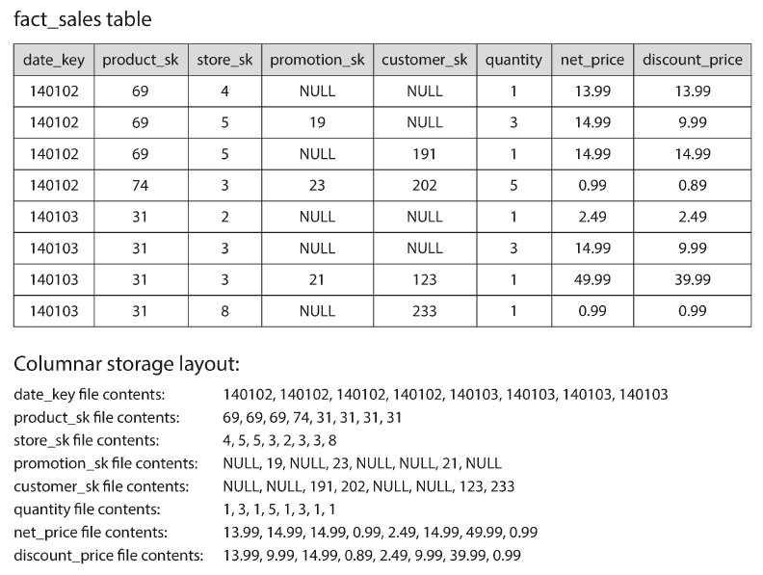
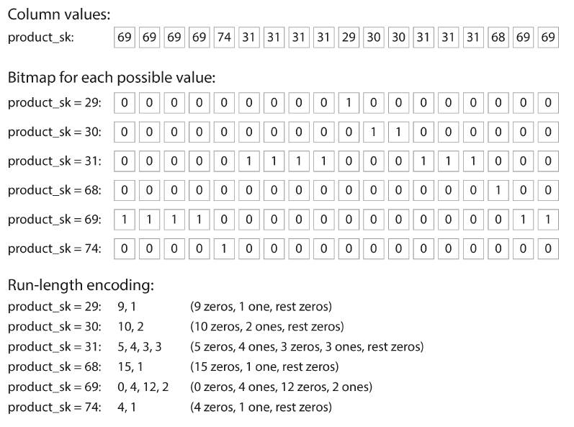
Column Storage System
Idea is simple: don’t store all the values from one row together, but store all the values from each column together instead.
Column Compression
Memory bandwidth and vectorized processing

Slide 21
Encoding and Evolution
Evolvability:
We should aim to build systems that make it easy to adapt to change: add new features, modify existing features
However in large system, code change cannot happen instantaneously
Rolling upgrade for server side
At mercy of user for client side
Backward Compatibility:
New code can read data that was written by older code
Forward Compatibility:
Old code can read data that was written by new code
Formats for Encoding Data:
In memory, data is kept in objects, structs, lists, arrays, hash tables, trees, etc. Optimized for easy access and manipulation by CPU.
When you want to write data to a file or send it over the network, you have to encode it as some kind of self-contained sequence of bytes (HTML, JSON, XML,…).
Encoding, serialization
In memory representation
Byte Sequence
Decoding, deserialization

Slide 22
Encoding and Evolution (Cont’d)
Language-specific Formats:
Many language has their own built-in support for encoding/decoding
Tied to a specific language, often lack of support forward/back compatibility, bad performance
JSON, XML, and Binary Variants:
JSON, XML, and CSV are textual formats, and thus somewhat human-readable
Each have their own drawbacks, but are generally good enough for many purposes, sending data between different organizations
Binary variants
Thrift and Protocol Buffers:
Protobuf invented by Google, Thrift (Facebook). Game changer for binary encoding

Slide 23
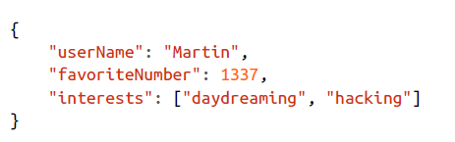
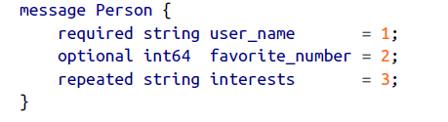
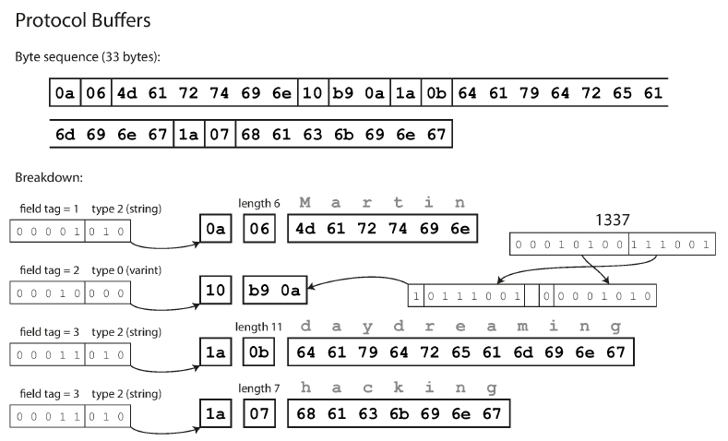
Encoding and Evolution (Cont’d)
81 bytes
Protocol Buffers each come with a code generation tool that takes a schema definition and produce classes that implement the schema in various languages.
field tags are compact way of saying what field we are talking about.

Slide 24
Encoding and Evolution (Cont’d)
How does Proto Buffer handle schema changes while keeping backward and forward compatibility?
encoded record is just the concatenation of its encoded fields. Each field is identified by its tag number and annotated with a data type
If value is not set, it simply omit from the encoded record;
Cannot change the field tag, which will invalid all existing encoded data.
Add new fields to the schema by giving each field a new tag number
Forward Compatibility (Old code can read data that was written by new code):
If new data includes a new field with a tag number it doesn’t recognize, it can simply ignore that field.
Backward Compatibility (New code can read data that was written by older code):
New code can always read old data, because the tag numbers still have the same meaning.

Slide 25

Data Flow through Service: Remote Procedure Call
Server:
The server expose an API over the network.
Client:
Connect to the servers to make requests to that API.
A server can itself be a client to another service, for example, a typical web app server acts as clients to a database.
Decompose a large application into smaller services by area of functionality (microservice architecture);
Make services independently deployable and evolvable by different teams without coordination;
Expect old and new versions of servers and clients to be running at the same time.

Slide 26
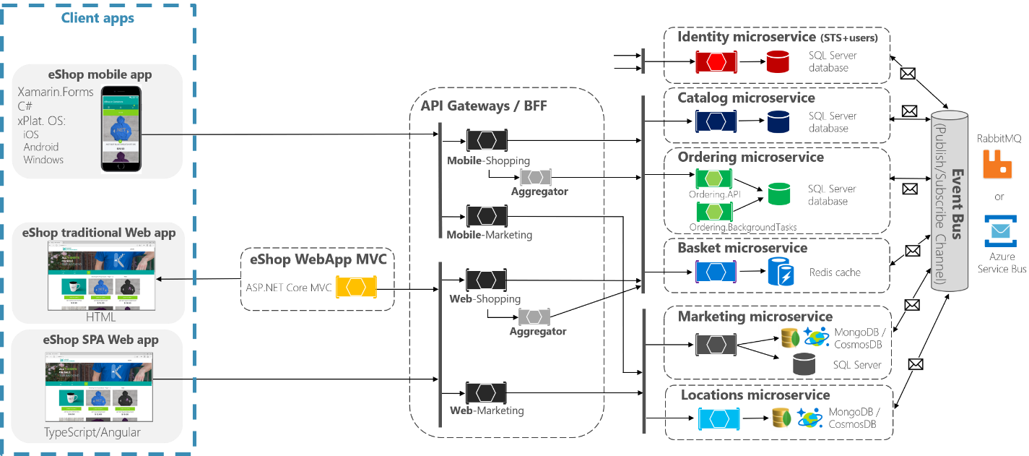
Data Flow through Service: RPC
Problems with RPC:
A local function call is predictable and either succeeds or fails whereas a network request is unpredictable:
request or response may be lost due to a network issue
Remote machine is slow or unavailable
A RPC call may return without a result, timeout and YDKW.
Retrying will cause the action to be performed multiple times, unless build deduplication (idempotence) into the protocol
latency is also wildly variable
Cannot pass in references or pointers to local object. Parameters must be encoded into a sequence of bytes and sent over networks
https://cloud.google.com/endpoints/docs/grpc/about-grpc

Slide 27
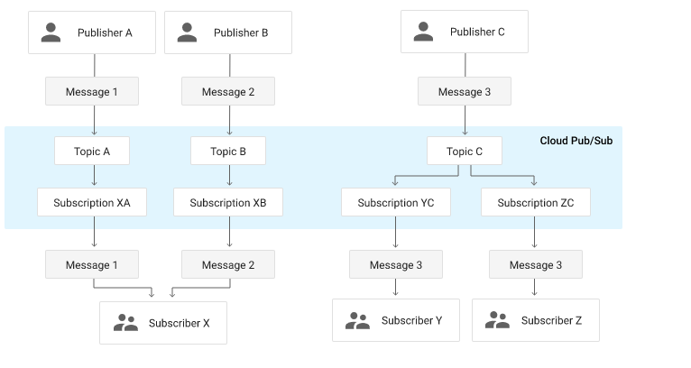
Message-Passing Dataflow
Asynchronous message-passing system:
Message is sent to a message broker which stores the message temporarily:
Act as a buffer if the recipient is unavailable or overloaded, and thus improve system reliability.
Automatically redeliver messages to a process that has crashed, and thus prevent messages from lost.
Avoids the sender needing to know the IP address and port number of the recipient (which is particularly useful in a cloud deployment where virtual machines often come and go).
Allows one message to be sent to several recipients.
Logically decouples the sender from the recipient (the sender just publishes messages and doesn’t care who consumes them).
https://cloud.google.com/pubsub/docs

Slide 28
Glossary So Far…
Average Response Time
Backward Compatibility
Batch Processing
Bloom Filters
B-Trees
Cache
Compaction
Deduplication
Encoding/Decoding
Forward Compatibility
Fragmentation
Graph Database
Indexing System
LSM-Trees
Memtable
Mergesort
Message passing data flow
Microservice
OLAP (Online Analytic Processing)
OLTP (Online Transaction Processing)
Protocol Buffer
PubSub
Range Queries
Reliability, Scalability, Maintainablity
Remote Procedure Call
Rolling Upgrade
Segment Merging
Service Level Agreements
Service Level Objectives
SSTable
Stream Processing
Tag Number
Tail Latency
Timeout
Transaction
Vertical & Horizontal Scaling

Slide 29
Operating System and System Design Lecture 2
April 11, 2020

Slide 30
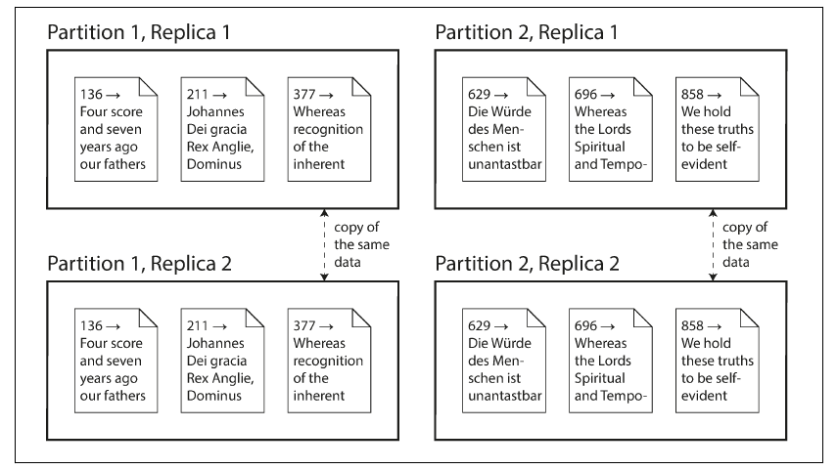
Distributed Data
Reasons & Motivation
Scalability: spread the load across multiple machines;
Fault tolerance/high availability: When one fails, another one can take over;
Latency: served from a datacenter that is geographically close to clients
Replication Versus Partitioning
Replication: Keeping a copy of the same data on several different nodes, potentially in different locations;
Partitioning: Splitting a big database into smaller subsets called partitions so that different partitions can be assigned to different nodes (sharding)

Slide 31
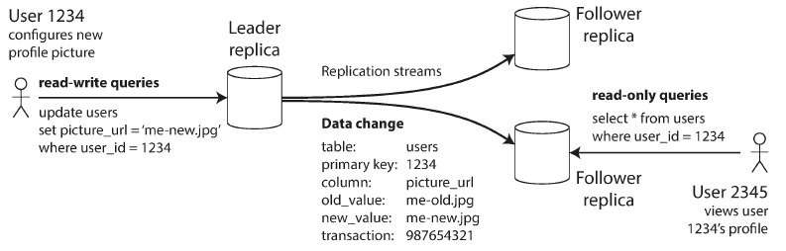
Replication (Leaders and Followers)
Replica: Each node that stores a copy of the database
how do we ensure that all the data ends up on all the replicas?
leader-based replication
One of the replicas is designated the leader (master or primary)
Write must send their request to leader
The other replicas are known as followers (read replicas, slaves, secondaries)
Leader send write to followers after writing to its local storage
Clients query leader or replicas for read

Slide 32
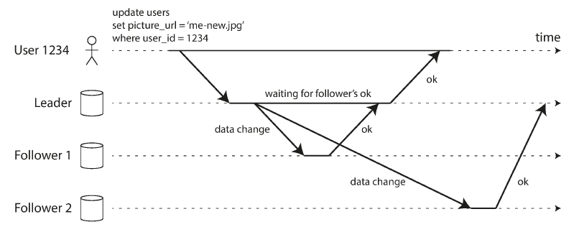
Replication (Leaders and Followers)
Synchronous: the leader waits until follower 1 has confirmed that it received the write before reporting success to the user
up-to-date copy of the data consistent with the leader
must block all writes if replica failed
Typically impractical
Asynchronous: the leader sends the message, but doesn’t wait for a response from the follower.
a write is not guaranteed to be durable even if it confirmed to the clients
continue processing writes even if all of its followers have fallen behind

Slide 33
Replication (Leaders and Followers)
Setting Up New Followers
Take a consistent snapshot of the leader’s database at some point in time
Copy the snapshot to the new follower node
Follower request all data after snapshot
processed the backlog of data changes (catch up)
Handling Node Outage
Follower failure: Catch-up recovery
connect to the leader and request all the data changes that missed. Perform a catch-up process
Leader failure: Failover
Determine a leader has failed. i.e., no response in 30s
Choose a new leader, election process
Reconfigure the system to use the new leader
fraught with things that can go wrong?

Slide 34
Replication (Leaders and Followers)
Setting Up New Followers
Take a consistent snapshot of the leader’s database at some point in time
Copy the snapshot to the new follower node
Follower request all data after snapshot
processed the backlog of data changes (catch up)
Handling Node Outage
Follower failure: Catch-up recovery
connect to the leader and request all the data changes that missed. Perform a catch-up process
Leader failure: Failover
Determine a leader has failed. i.e., no response in 30s
Choose a new leader, election process
Reconfigure the system to use the new leader
fraught with things that can go wrong?
Eventual consistency
the followers will eventually catch up and become consistent with the leader
Replication lag
the delay between a write happening on the leader and being reflected on a follower

Slide 35
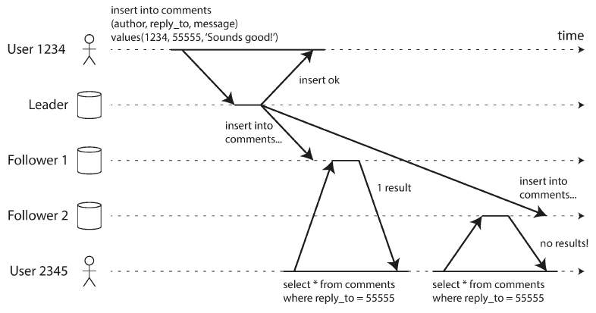
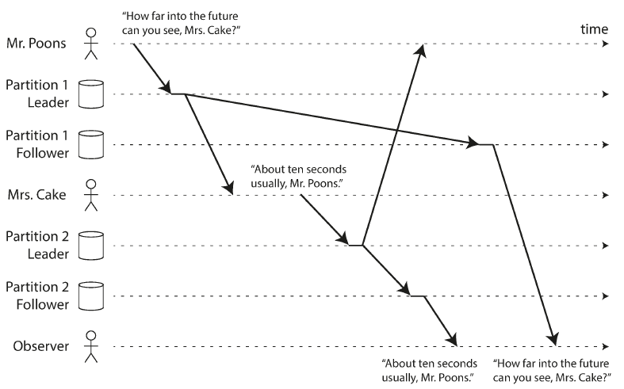
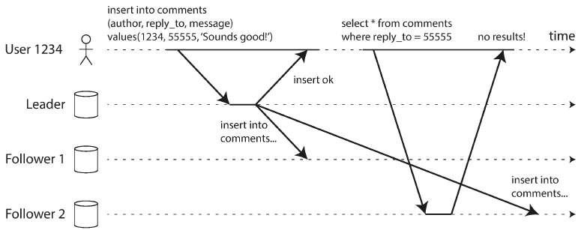
Replication (Leaders and Followers)
Read-after-write consistency
Read from leader if user may modify; (Facebook page)
Track the time of the last update, read from leader within certain time;
Monotonic Reads
each user always makes their reads from the same replica;
Consistent prefix reads
if a sequence of writes happens in a certain order, then anyone reading those writes will see them appear in the same order; (see “The “happens-before” relationship and concurrency” )

Slide 36
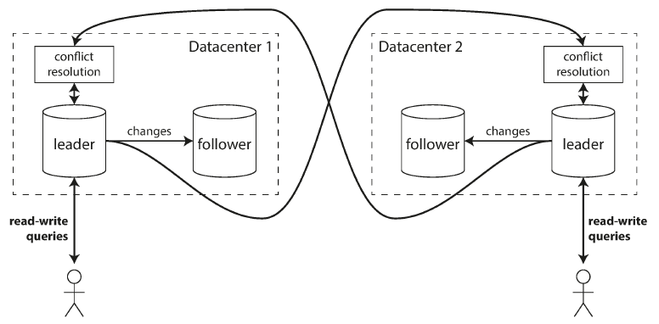
Replication (Multi-Leader Replication)
each node that processes a write must forward that data change to all the other nodes.
each leader simultaneously acts as a follower to the other leaders
Multi-datacenter operation
One leader for each datacenter;
Performance
Hidden latency replicated asynchronously to the other datacenters
Tolerance of datacenter outages
Need to resolve conflict
Same data concurrently modified in two different datacenters
Other cases
Clients with offline operation
Real-time collaborative editing

Slide 37
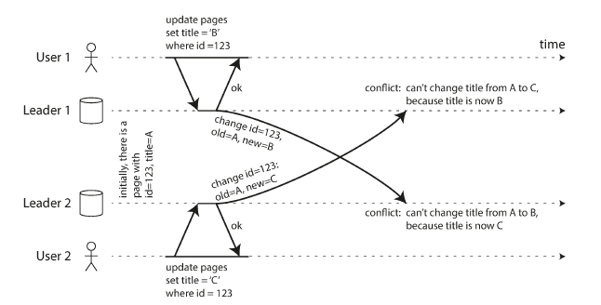
Replication (Multi-Leader Replication)
Handling write conflict
Conflict avoidance: particular record go through the same leader
Converging toward a consistent state:
Give each write a unique ID, pick highest
Give each replica a unique ID, pick higher ID
Record conflict and let user decide

Slide 38
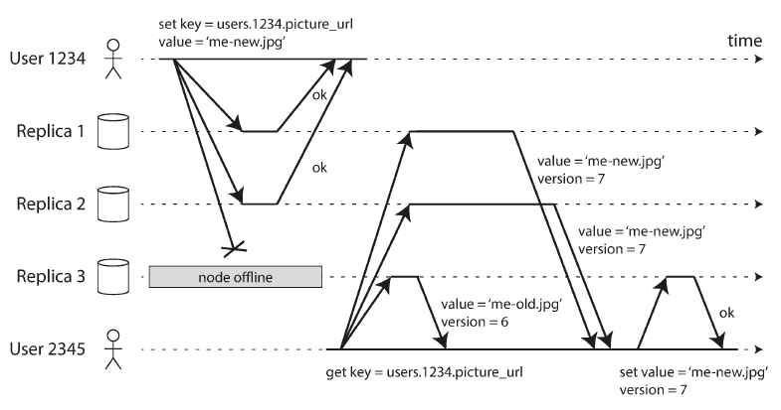
Replication (Leaderless Replication)
Allowing any replica to directly accept writes from clients
Writing to the Database When a Node Is Down:
Consider write to be successful when received ok response from majority nodes
read requests are also sent to several nodes in parallel, use version number to determine the up-to-date value
Quorums for reading and writing
if there are n replicas, every write must be confirmed by w nodes to be considered successful, and we must query at least r nodes for each read. (In our example, n = 3, w = 2, r = 2.) As long as w + r > n, we expect to get an up-to-date value when reading, because at least one of the r nodes we’re reading from must be up to date.
In general, it’s not so simple. Stronger guarantees generally require transactions or consensus.
Measuring and monitoring replica staleness.

Slide 39
Replication (Leaderless Replication)

Slide 40
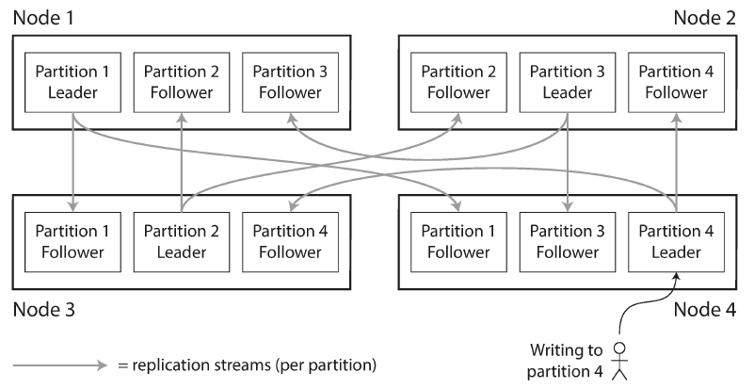
Partitioning
Partitioning and Replication
Partitioning is usually combined with replication so that copies of each partition are stored on multiple nodes
A node may store more than one partition.
A partition can be stored in multiple nodes
Skewed: If the partitioning is unfair, so that some partitions have more data or queries than others, we call it skewed
Hot spot: partition with disproportionately high load
Partitioning of Key-Value Data
By key range
Range of keys are not necessarily evenly spaced
Certain access pattern can lead to hot spots
By Hash of key
Also called as Consistent Hashing;
Loss the ability to do efficient range queries;
Can’t avoid hot spot (Twitter), relies on application to do further process & split;

Slide 41
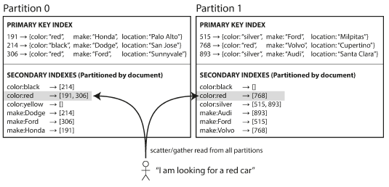
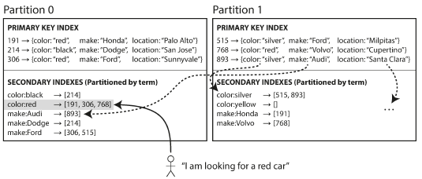
Partitioning and Secondary Indexes
Partitioning Secondary Indexes by Document
Partitioning Secondary Indexes by Term
Write efficient
Query a partitioned database scatter/gather
Read queries can be expensive
Prone to tail latency amplification
Read efficient
Writes are slower and more complicate

Slide 42
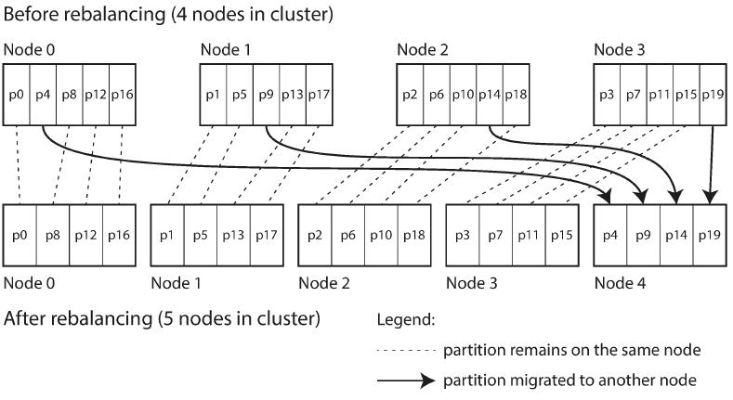
Rebalancing Partitions
When the query throughput increases, the dataset size increases or a machine fail and others need to take over.
Requirements:
Load should be shared fairly;
Continue accepting reads and writes;
No more data than necessary should be move between nodes.
Strategies for Rebalancing
New node steal a few partitions from existing nodes
No change to #partitions or assignment of keys to partitions
Only change the assignment of partitions to nodes
Dynamic partitioning
Split partition when it exceed a configured size
Merge when it shrink below some threshold

Slide 43
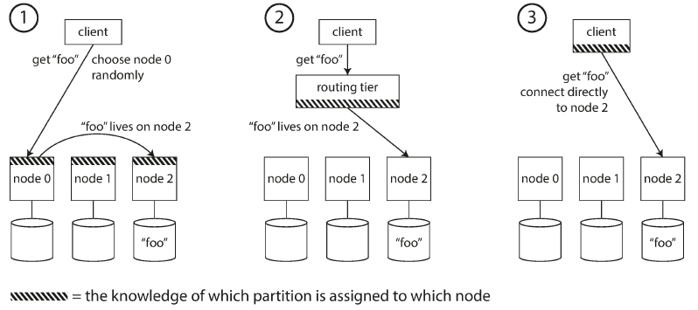
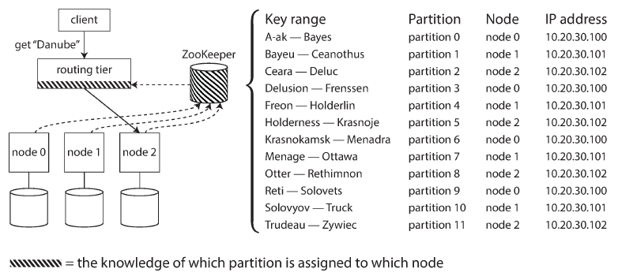
Request Routing
How does a client knows which node to connect to?
Approaches:
Allow clients to contact any node which further forward request
Send the request to a routing tier which distribute the request
Require the client to aware of the partitioning/assignment
Rely on a service (Zookeeper)
maintains the authoritative mapping of partitions to nodes.
Notify the routing tier to keep its routing info up to date whenever a partition changes ownership, or a node is added or removed

Slide 44
Transaction
A transaction is a way for an application to group several reads and writes together into a logical unit. Either the entire transaction succeeds (commit) or it fails (abort, rollback). If it fails, the application can safely retry.
ACID (Atomicity)
if a transaction was aborted, the application can be sure that it didn’t change anything, so it can safely be retried..
ACID (Consistency)
you have certain statements about your data (invariants) that must always be true.
ACID (Isolation)
concurrently executing transactions are isolated from each other: they cannot step on each other’s toes.
ACID (Durability)
Durability is the promise that once a transaction has committed successfully, any data it has written will not be forgotten, even if there is a hardware fault or the database crashes

Slide 45
Single-Object and Multi-Object Operations
Single-Object Operations
Storage engines almost universally aim to provide atomicity and isolation on the level of a single object (such as a key-value pair) on one node.
ACID (Atomicity)
implemented using a log for crash recovery
ACID (Isolation)
Implemented using a lock on each object.
Multi-Object Operations
In a relational data model, a row in one table often has a foreign key reference to a row in another table.
In databases with secondary indexes, the indexes also need to be updated every time you change a value
Retrying an aborted transaction is a simple and effective error handling mechanism, it isn’t perfect:
Transaction perform twice if no de-duplication
Make problem worse if overload
Pointless if permanent error
Side effects outside of the database happen multiple times

Slide 46
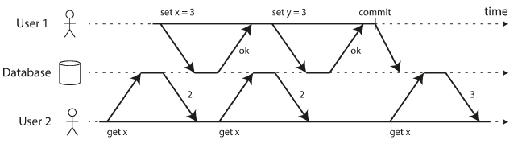
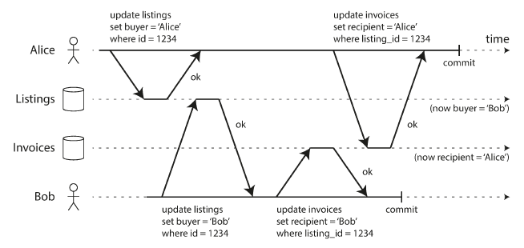
Weak Isolation Levels (Read Committed)
Isolation is complex and usually come at performance cost
Read Committed
No dirty reads
When reading from the database, you will only see data that has been committed;
Remembers both the old committed and the new value, return depending on status of transaction.
2) No dirty writes
Only overwrite data that has been committed;
Prevent dirty writes by using row-level locks: acquire a lock on row/document and hold it until transaction committed or aborted.

Slide 47
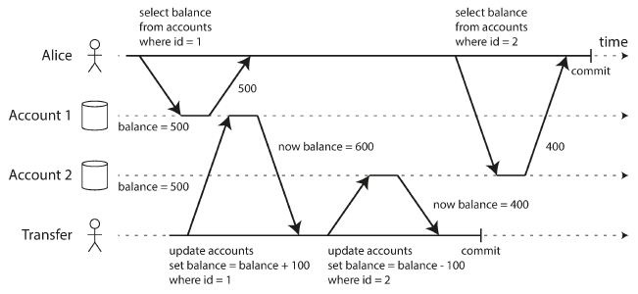
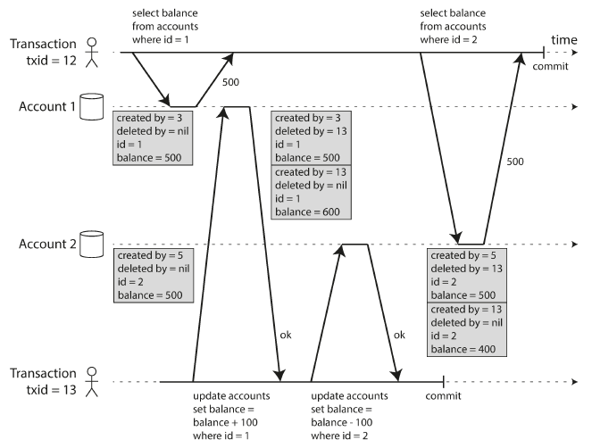
Snapshot Isolation and Repeatable Read
Read-committed isolation doesn’t solve all concurrency problems.
Result in temporary inconsistency;
Some situations cannot tolerate this: Backups, Analytic queries, integrity checks
Snapshot isolation
Transaction only sees all the data that was committed;
Implementation
DB keeps several different committed versions of objects;
Visibility rules for observing a consistent snapshot (visible if created transaction is committed but deleted transaction is not.)
Implementation details affect performance, i.e. append-only/copy-on-write
The lost update problem can occur if an application update record through read-modify-write cycle.
DB provide atomic update operations by taking an exclusive lock on objects.
Use explicit locking ( SQL clause)

Slide 48
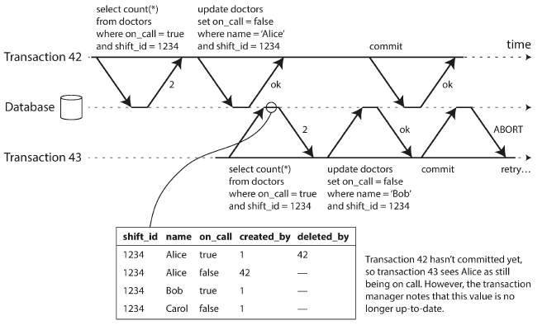
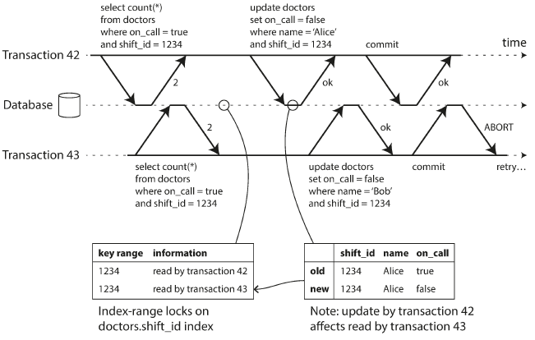
Serializability
Serializable isolation (strongest isolation level, prevents all possible race conditions.)
Actual Serial Execution
Keep entire DB in memory;
OLTP transactions are usually short & small.
Limited to a single CPU core
Stored procedures and Partitioning, cross-partitioning has a hard limit
2) Two-phase locking (2PL)
Concurrently read is possible
Writers don’t just block other writers; they also block readers and vice versa.
Implement using locks in shared mode (read) or in exclusive mode (write)
3) Serializable Snapshot Isolation (SSI)
Provides full serializability with little penalty; (no-block w&r)
Optimistic concurrency control
Decisions based on an outdated premise
Detecting reads of a stale MVCC object version (uncommitted write occurred before the read) and abort if abnormal
Detecting writes that affect prior reads (the write occurs after the read)

Slide 49
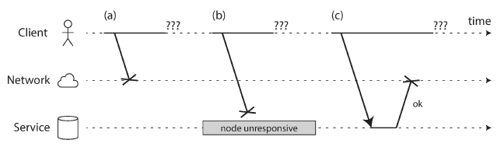
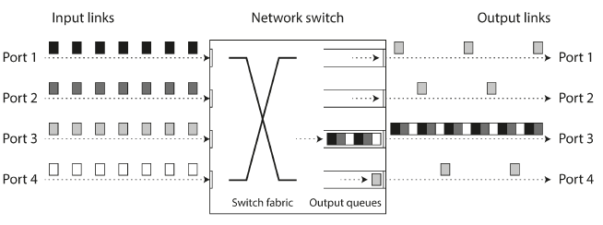
The Trouble With Distributed Systems
Faults and Partial Failures (Nondeterministic)
Unreliable Network
Request lost or delayed / Remote node failure or not responding / Response lost or delayed
Detecting Faults
Load balancer stop sending request to dead node
Replication promote leaders if existing one failed
Timeouts and Unbounded Delays
Network congestion and queueing (switch, OS, TCP)
Synchronous Versus Asynchronous Networks
Network optimized for bursty traffic

Slide 50
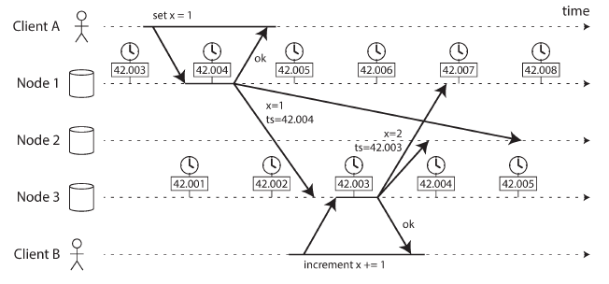
Unreliable Clocks
Monotonic Versus Time-of-Day Clocks
Time-of-day clocks
Current date and time according to some calendar
Synchronized with NTP (Network Time Protocol)
Monotonic clocks
Always move forward, adjust frequency
Suitable for measuring duration
Clock Synchronization and Accuracy
Quartz clock drift, NTP synchronization delay by network congestion, Leap second
Relying on Synchronized Clocks
Database writes can mysteriously disappear
NTP’s synchronization won’t help (limit by network delay, local quartz clock drift)
Google Spanner TrueTime API reports the confidence level, wait for the length of confidence interval before committing a read-write transaction
Deploy a GPS receiver or atomic clock to keep interval small
Process Pause
Could happens
Garbage collector “stop-the-world”, virtual machine suspend and resume, OS context switch to other threads, disk I/O, virtual memory swapping to disk, …
Response time guarantee
Example: real-time operating system (RTOS)
Expensive, have low throughput

Slide 51
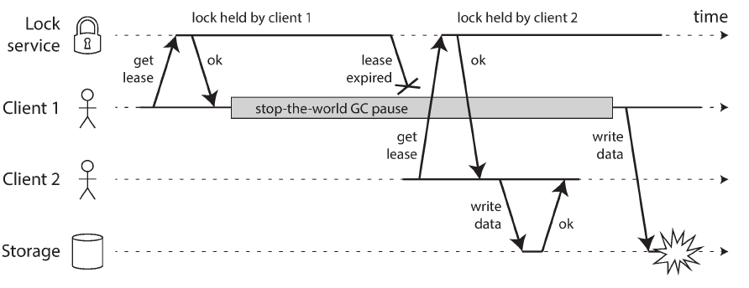
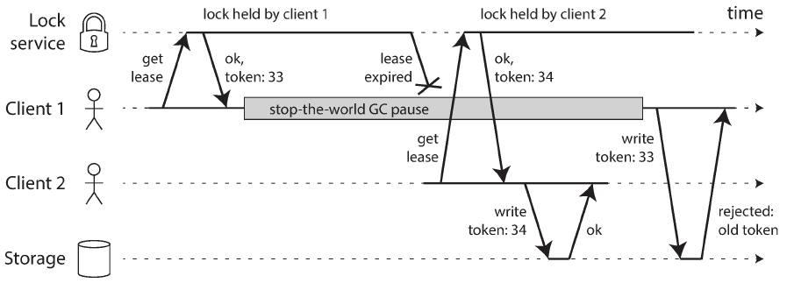
Knowledge, Truth, and Lies
The Truth Is Defined by the Majority
cannot exclusively rely on a single node
rely on a quorum, voting among the nodes
The leader and the lock
Situation of only-one: leader, lock, etc.
Even if a node believes that it is “the chosen one”, doesn’t mean a quorum of nodes agree
Fencing tokens in lock service, but require resource to actively check tokens
Byzantine Faults
So far we assume that nodes are unreliable but honest.
The risk of node may lie is known as Byzantine Faults
the problem of reaching consensus in this untrusting environment is known as the Byzantine Generals Problem
Byzantine fault-tolerant
Incorrect implementation of a distributed lock
allowing writes only in the order of increasing fencing tokens.

Slide 52
Consistency and Consensus

Slide 53
Design Pattern Lecture C
April 25, 2020

Slide 54
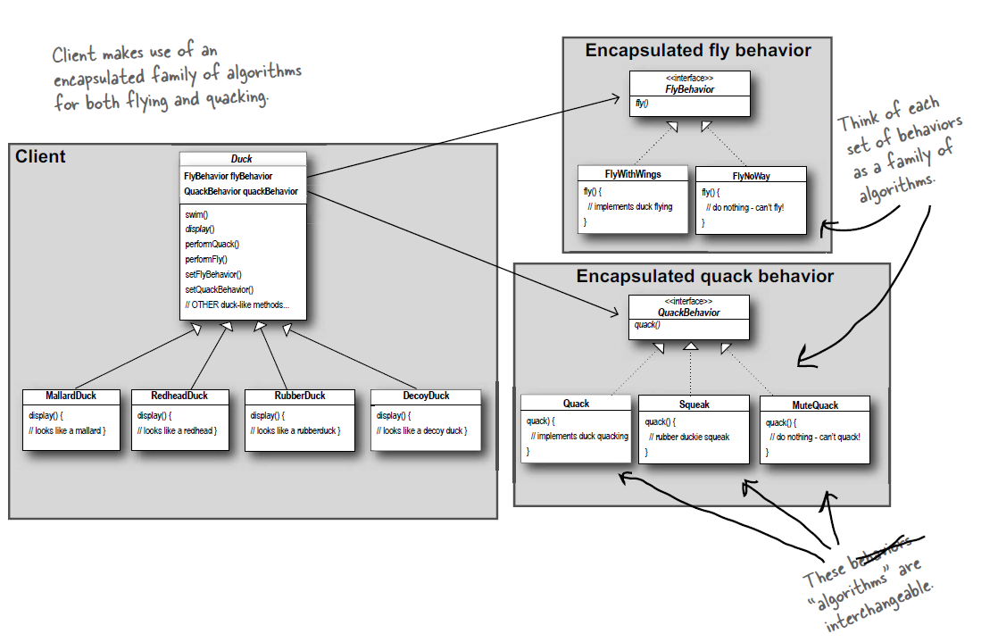
Strategy Pattern
The Strategy Pattern defines a family of algorithms, encapsulates each one, and makes them interchangeable. Strategy lets the algorithm vary independently from clients that use it.
Principle:
Identify the aspects of your application that vary and separate them from what stays the same.
Program to an interface, not an implementation.
Favor composition over inheritance. It lets you change behavior at runtime.

Slide 55
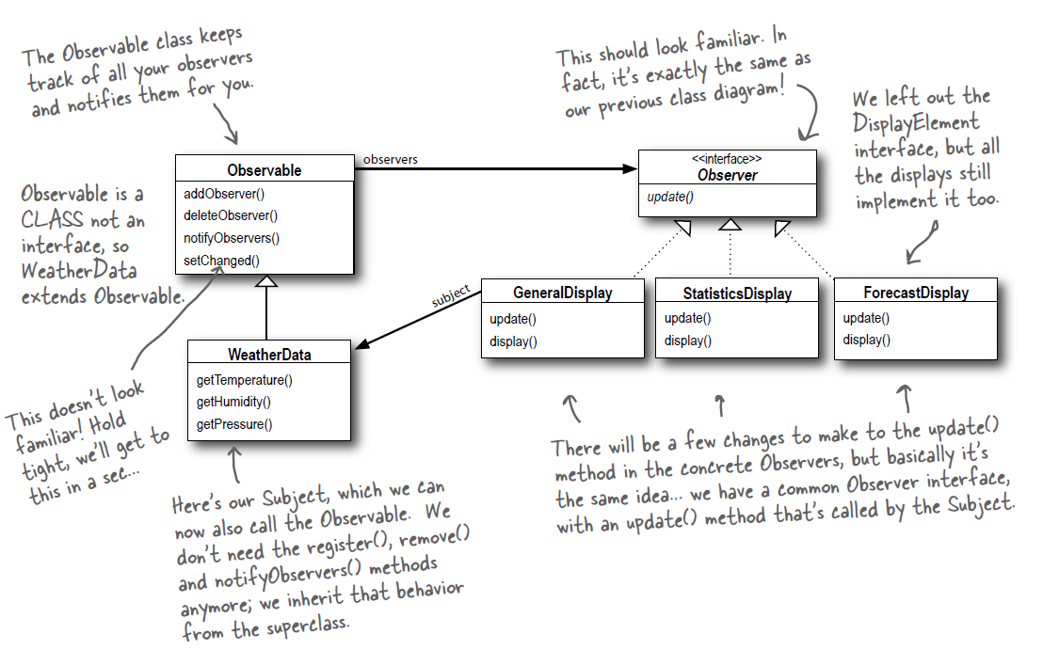
Observer Pattern
The Observer Pattern defines a one-to-many dependency between objects so that when one object changes state, all of its dependents are notified and updated automatically.
Principle:
Strive for loosely coupled designs between objects that interact.
Summary:
Observable subject only need to know about an observer implement a certain interface.
Add new observer anytime and no need to modify observable.
Change to either one won’t affect the other.

Slide 56
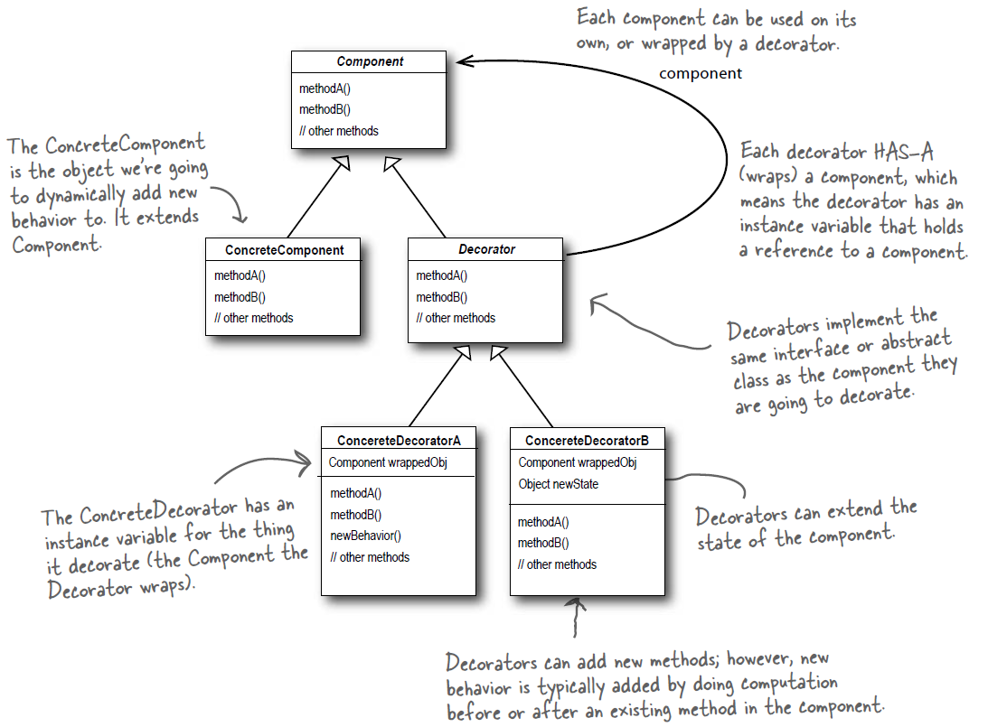
Decorator Pattern
The Decorator Pattern attaches additional responsibilities to an object dynamically. Decorators provide a flexible alternative to sub-classing for extending functionality.
Principle:
Classes should be open for extension, but closed for modification.
Summary:
Decorators have the same supertype as the objects they decorate
Each decorator HAS-A reference to componet
You can use one or more decorators to wrap an object
The decorator adds its own behavior either before and/or after delegating to the object it decorates to do the rest of the job.
Objects can be decorated at any time dynamically at runtime

Slide 57
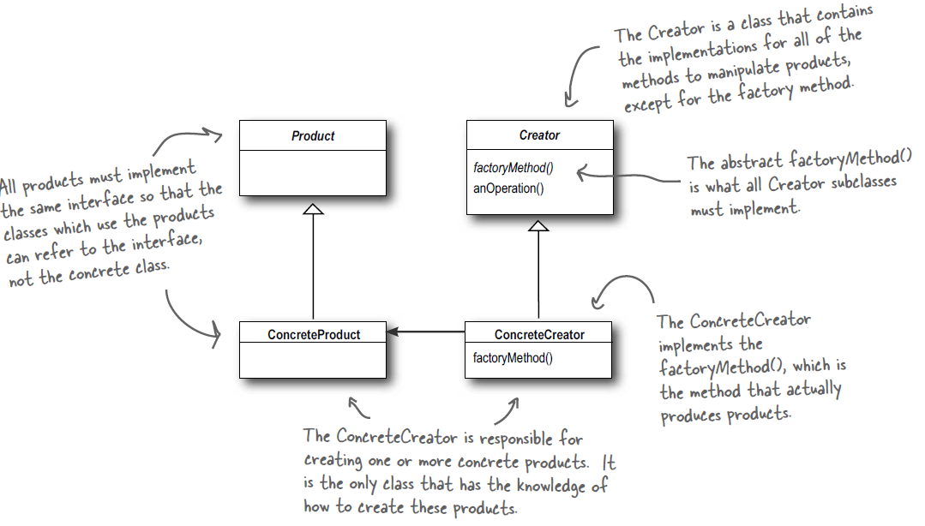
Factory Pattern
The Factory Method Pattern defines an interface for creating an object, but lets subclasses decide which
class to instantiate. Factory Method lets a class defer instantiation to subclasses.
Principle:
Depend upon abstractions. Do not depend upon concrete classes.
Summary:
High-level should not depend on Low-level components, rather they should both depend on abstraction (Dependency Inversion)
No variable should hold a reference to a concrete class
No class should derive from a concrete class
No method should override an implemented method of any of its base classes

Slide 58
Abstract Factory Pattern
The Abstract Factory Method Pattern.
Principle:
Summary:

Slide 59
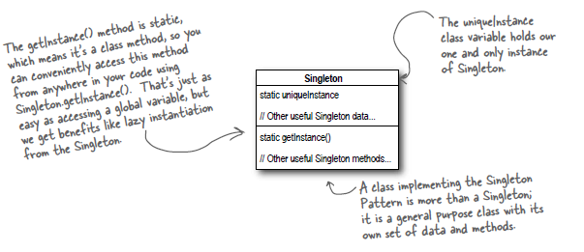
Singleton Pattern
The Singleton Factory ensures a class has only one instance and provides a global point of access to it.
Summary:
Use lazy instantiation if not necessarily used;
Add mutex lock in getInstance function to avoid multithread race condition;
Do thing if not the performance bottleneck;
Move to an eagerly created instance;
Double check locking to reduce the need of lock acquisition;

Slide 60
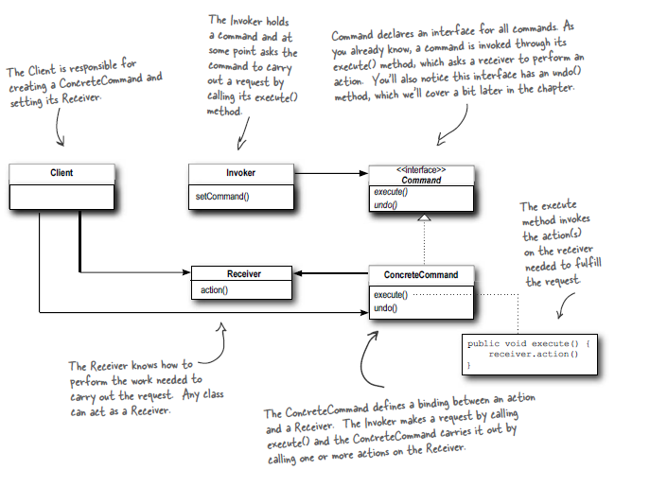
Command Pattern
The Command Pattern encapsulates a request as an object, thereby letting you parameterize other objects with different requests, queue or log requests, and support undoable operations.
Summary:
The Command Pattern decouples an object, making a request from the one that knows how to perform it.
An invoker makes a request of a Command object by calling its execute() method, which invokes those actions on the receiver.
Commands may support undo by implementing an undo method
Macro Commands are a simple extension of Command that allow multiple commands to be invoked
Commands may also be used to implement logging and transactional systems.

Slide 61

The Adapter Pattern
The Adapter Pattern converts the interface of a class into another interface the clients expect. Adapter lets classes work together that couldn’t otherwise because of incompatible interfaces.
Summary:
When you need to use an existing class and its interface is not the one you need, use an adapter.
An adapter changes an interface into one a client expects.
Implementing an adapter may require little work or a great deal of work depending on the size and complexity of the target interface.

Slide 62

The Facade Pattern
The Facade Pattern provides a unified interface to a set of interfaces in a subsytem. Facade defines a higher level interface that makes the subsystem easier to use.
Principle:
Principle of Least Knowledge - talk only to your immediate friends
Summary:
A facade decouples a client from a complex subsystem
Requires that we compose the façade with its subsystem and use delegation to perform the work of the facade.
You can implement more than one facade for a subsystem

Slide 63

The Template Pattern
The Template Method Pattern defines the skeleton of an algorithm in a method, deferring some steps to subclasses. Template Method lets subclasses redefine certain steps of an algorithm without changing the algorithm’s structure.
Principle:
The Hollywood Principle - Don’t call us, we’ll call you
Summary:
Gives us an important technique for code re-use.
abstract class may define concrete methods, abstract methods and hooks.
Abstract methods are implemented by subclasses.
Hooks are methods that do nothing or default behavior in the abstract class, but may be overridden in the subclass

Slide 64

The Iterator Pattern
The Iterator Pattern provides a way to access the elements of an aggregate object sequentially without exposing its underlying representation.
Principle:
A class should have only one reason to change.
Summary:
allows access to an aggregate’s elements without exposing its internal structure.
relieve the aggregate of the responsibility of supporting operations for traversing its data.
provides a common interface for traversing the items of an aggregate, allowing you to use polymorphism

Slide 65

The Composite Pattern
The Composite Pattern allows you to compose objects into tree structures to represent part-whole hierarchies. Composite lets clients treat individual objects and compositions of objects uniformly.
Summary:
provides a structure to hold both individual objects and composites
allows clients to treat composites and individual objects uniformly
Components may be other composites or leaf nodes.

Slide 66

The State Pattern
The State Pattern allows an object to alter its behavior when its internal state changes. The object will appear to change its class.
Summary:
allows an object to have many different behaviors that are based on its internal state.
the State Pattern represents state as a full-blown class.
The Context gets its behavior by delegating to the current state object it is composed with.
By encapsulating each state into a class, we localize any changes that will need to be made.
State Pattern allows a Context to change its behavior as the state of the Context changes
State transitions can be controlled by the State classes or by the Context classes

Slide 67

The Proxy Pattern
The Proxy Pattern provides a surrogate or placeholder for another object to control access to it.
Summary:
Provides a representative for another object in order to control the client’s access to it;
Variants of proxy: remote proxies, virtual proxies, protection proxies, caching proxies, synchronization proxies, firewall proxies, copy-on-write proxies;
Proxy is structurally similar to Decorator, but the two differ in their purpose;
The Decorator Pattern adds behavior to an object, while a Proxy controls access.

Slide 68
Left-Over Patterns
Use the Builder Pattern to encapsulate the construction of a product and allow it to be constructed in steps.
Use the Chain of Responsibility Pattern when you want to give more than one object a chance to handle a request.
Benefit:
Encapsulates the way a complex object is constructed.
Allows objects to be constructed in a multistep and varying process (as opposed to one step factories).
Hides the internal representation of the product from the client.
Product implementations can be swapped in and out because the client only sees an abstract interface.
Benefit:
Decouples the sender of the request and its receivers.
Simplifies your object because it doesn’t have to know the chain’s structure and keep direct references to its members.
Allows you to add or remove responsibilities dynamically by changing the members or order of the chain.

Slide 69
Left-Over Patterns (Cont’d)
Use the Flyweight Pattern when one instance of a class can be used to provide many “virtual instances.”
Use the Mediator Pattern to centralize complex communications and control between related objects.
Benefit:
Reduces the number of object instances at runtime, saving memory.
Centralizes state for many “virtual” objects into a single location.
The Flyweight is used when a class has many instances, and they can all be controlled identically.
Benefit:
Increases the reusability of the objects supported by the Mediator by decoupling them from the system.
Simplifies maintenance of the system by centralizing control logic.
Simplifies and reduces the variety of messages sent between objects in the system.

Slide 70
Left-Over Patterns (Cont’d)
Use the Memento Pattern when you need
to be able to return an object to one of its
previous states; for instance, if your user
requests an “undo.”
Use the Prototype Pattern when creating an instance of a given class is either expensive or complicated.
Benefit:
Keeping the saved state external from the key object helps to maintain cohesion.
Keeps the key object’s data encapsulated.
Provides easy-to-implement recovery capability.
The Memento is used to save state.
A drawback to using Memento is that saving and restoring state can be time consuming.
Benefit:
Hides the complexities of making new instances from the client.
Provides the option for the client to generate objects whose type is not known.
In some circumstances, copying an object can be more efficient than creating a new object.
Prototype should be considered when a system must create new objects of many types in a complex class hierarchy.

Slide 71
Left-Over Patterns (Cont’d)
Use the Visitor Pattern when you want to
add capabilities to a composite of objects
and encapsulation is not important.
Benefit & Drawbacks:
Allows you to add operations to a Composite structure without changing the structure itself.
Adding new operations is relatively easy.
The code for operations performed by the Visitor is centralized.
The Composite classes’ encapsulation is broken when the Visitor is used.

